Slide 1
The PIC microcontroller
PIC18F4520: Instruction Set – Part 3

Slide 2
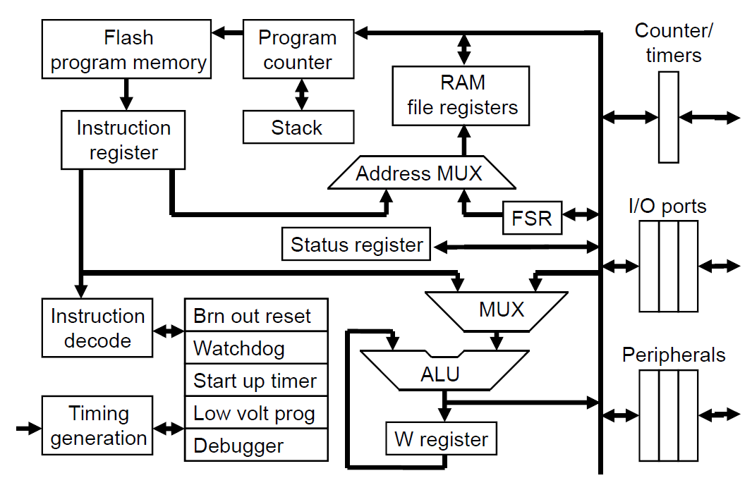
PIC18F: Controller Architecture

Slide 3
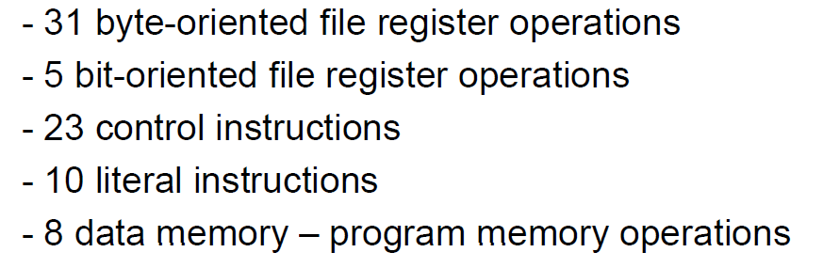
PIC18F: Instruction set grouping

Slide 4
PIC18F: Notational convention
WREG
W Register
FREG
File Register (any register location from GPR Bank 0 / SFR)
[X]
Contents of register X
[WREG] = 0x02 ↔ WREG’s contents become 0x02
[0x20] = 0x34 ↔ RAM File Register 0x20 content becomes 0x34
[X] = [Y] ↔ Contents of Y are copied into X
Number systems
Decimal | d’10’
Hexadecimal | h’4A’ or 0x4A
Binary | b’1000 0010’

Slide 5
The world of pointers

Slide 6
Programming: Concept of variables
Programs use ‘variables’ to hold values
x = 5, y = 10.25
Variables come in many types
Simple types
Integers – Hold integer values (+, 0, -)
int i = 10, j = -100;
Characters – Hold characters (ASCII)
char c = ‘a’;
Floats – Hold floating point (real number) values
float f = 0.123, g = -1.453
Strings – Hold several characters ‘together’
char str[] = ‘hello!’
Complex types
arrays, complex numbers
trees, lists, stacks, heaps, dictionaries, …
Pointers are a special type of variable
They don’t hold values, but ‘addresses’ of other variables

Slide 7
Programming: The pointer concept
Let’s take a variable (say, x )
x = 10
x has a value, and the value is 10
x has to exist somewhere in data memory
x has an address, say 0x20
A pointer (say, p) can hold x’s address for us
Effectively ‘pointing to x’
So, p = 0x20
This gives us 2 methods to access / change x
Directly by saying x = 100
Indirectly by going through p
x
0x20
d’10’
p
0xMN
0x20

Slide 8
Addressing modes

Slide 9
PIC18F: Addressing modes
Immediate addressing
Using literal instructions
Number appearing in the instruction is ‘data’
Example: ADDLW 0x20 ; [WREG] = [WREG] + 0x20
Register direct addressing
FREG used for computation / movement
Number appearing in the instruction is ‘FREG location’
Example: ADDWF 0x20, F ; [FREG] = [FREG] + [WREG]
Register indirect / pointer addressing
Use pointer register to address FREG
Table addressing
Moving data from code memory to data memory

Slide 10
Pointer registers

Slide 11
PIC18F: Pointer registers
PIC18F has a pointer register framework
Pointer register
Does not hold a value
Instead, holds address of another FREG
PIC18F pointer registers are called FSRs
File Selection Register Not SFR!
PIC18F has 3 such FSRs
FSR0, FSR1, FSR2 – 12 bits each
Each such FSR can ‘point’ to any FREG (0x000 to 0xFFF)
But not by default!
We have to make it point to an FREG
The instruction to do that is LFSR

Slide 12
PIC18F: Instructions - LFSR
LFSR
Load an FSR with the address of an FREG
Syntax: LFSR n, FREG_address where 0 ≤ n ≤ 2
Example:
CNT_REG EQU 0x20
LFSR 0, CNT_REG
Effect: [FSR0] = CNT_REG’s address = 0x20
After this point, we can use FSR0 to access CNT_REG
But how? Not by using FSR0, but another register INDF0
Example:
MOVLW 0x10
MOVWF INDF0
Effect: [CNT_REG] = [0x20] = 0x10!
So, FSR points and INDF gives data access

Slide 13
PIC18F: FSR family
PIC18F has 3 FSRs and correspondingly, 3 INDFs
Care should be taken when using pointers to:
Load proper FSR before doing data access
Called pointer initialization
Using the proper, corresponding INDF for data access
Called pointer de-referencing
Bad example:
LFSR 0, 0x20
MOVWF INDF2
FSR | INDF
FSR0 | INDF0
FSR1 | INDF1
FSR2 | INDF2

Slide 14
Programming: Chunk move – Idea
Real-world data moves:
programs need to move
chunks of data
from one location in memory
to another location in memory
Typical problem statement:
Move 10 bytes of data from starting location 0x20 to location starting at 0x30
Called memcopy
Most efficiently done using pointer-loop combo
0x20 | 0x21 | … | 0x29
0x01 | 0x02 | … | 0x0A
0x30 | 0x31 | … | 0x39
0x01 | 0x02 | … | 0x0A

Slide 15
PIC18F: Chunk move – Method
Set up a loop counter variable
Use 2 pointers – one for source, another for destination
Say, FSR0 for src, FSR1 for dest
Initialize pointers to point to src and dest
LFSR 0, SRC_REG ; [FSR0] = SRC_REG
LFSR 1, DST_REG ; [FSR1] = DST_REG
Use a MOVFF to move the underlying data
MOVFF INDF0, INDF1
Effect: [DST_REG] = [SRC_REG]
Increment pointers (not SRC_REG, DST_REG)
INCF FSR0L
INCF FSR1L
Rinse and repeat this loop using counter variable
Issue: FSRs are 12-bit! ALU is 8-bit!

Slide 16
PIC18F: Pointer register increments
12-bit FSRs cannot be incremented / decremented in ALU
Handling 12-bit operation – special registers
Complete FSR family
Pointer register | Effect / usage
POSTINC | Get the data, then increment FSR
POSTDEC | Get the data, then decrement FSR
PREINC | Increment FSR, then get the data
FSR0 | FSR1 | FSR2
INDF0 | INDF1 | INDF2
POSTINC0 | POSTINC1 | POSTINC2
POSTDEC0 | POSTDEC1 | POSTDEC2
PREINC0 | PREINC1 | PREINC2

Slide 17
PIC18F: An insight into POSTINC
Move contents of:
0x20 to 0x30, and 0x21 to 0x31
Initialize pointer registers
LFSR 1, 0x20 ; [FSR1] = 0x20
LFSR 2, 0x30 ; [FSR2] = 0x30
Get 0x20’s contents into W, thence to 0x30
Not with INDF, but with POSTINC
MOVF POSTINC1, W ; [WREG] = [0x20], FSR1+=1
MOVWF POSTINC2 ; [0x30] = [WREG], FSR2+=1
Now, FSR1 points to 0x21, FSR2 to 0x31
MOVFF POSTINC1, POSTINC2
; [0x31] = [0x21], FSR1+=1, FSR2+=1
Using a POSTINC gives us a ‘free’ post-increment of the FSR
Loop this to get smooth movement of large chunks!
2 variants!

Slide 18
PIC18F: Chunk move problem – solved!
Moving 10 bytes from 0x20 to 0x30 using POSTINC pointers
#include "P18F4520.inc"
SRC_REG EQU 0x20
DST_REG EQU 0x30
CNT_REG EQU 0x10
COUNT EQU d'10'
ORG 0x0
MOVLW COUNT
MOVWF CNT_REG
LFSR 1, SRC_REG
LFSR 2, DST_REG
LOOP MOVFF POSTINC1, POSTINC2
DECFSZ CNT_REG, F
BRA LOOP
GOTO $
END

Slide 19
Table addressing

Slide 20
Computing: Remembering data!
PIC18F has 2 memories
Non-volatile Code Memory
Volatile Data Memory
By default
Code/program/instructions go into Code Memory
Data goes into Data Memory
But what if we want to remember some data?
Keep this data in code memory!
But how does my code access this data?
All instructions learnt so far deal only with data memory

Slide 21
PIC18F: Putting data into code memory
Special directives to put data into code memory
DB (Define Byte)
Examples:
ORG 0x400
VAL1 DB 0x20 ; hexadecimal
VAL2 DB h’30’ ; hexadecimal
VAL3 DB d’25’ ; decimal
VAL4 DB b’10000010’ ; binary
VAL5 DB ‘a’ ; character
VAL6 DB “Hello!”, 0 ; string, null-terminated
That’s fine, but which location in code memory?
Should never be ORG 0x0!

Slide 22
PIC18F: Mixing Code & Data
Putting code and data into code memory
#include “P18F4520.inc”
REG1 EQU 0x20
ORG 0x0
MOVLW 0x00
MOVWF REG1
ORG 0x400
DAT1 DB d’201’
STR1 DB “Hello!”, 0
END
Ensure that they don’t mix / overlap!
Code
Data
non-volatile!

Slide 23
PIC18F: Getting data from code memory
Data in code memory cannot be acted upon!
To use it, we need it back in data memory
Dedicated set of instructions and 2 SFRs
For getting (non-volatile) data
from code memory
back into data memory
Table processing framework
SFRs:
TABLAT (8-bit), TBLPTR (21-bit)
Instructions:
TBLRD*, TBLRD*+, TBLRD+*, etc.

Slide 24
PIC18F: Table processing – SFRs
TABLAT – Table Latch
8-bit register
Intermediary for data move from Code memory to Data memory
Receives the data byte on a Table Read
From here, move it to WREG or any other FREG
TBLPTR – Table Pointer Register
21-bit register – cannot be initialized in 1 instruction
Split into 3 parts:
TBLPTRL (low - 8-bits)
TBLPTRH (high - 8-bits)
TBLPTRU (upper - 5-bits)
TBLPTRU
TBLPTRH
TBLPTRL
5-bits
8-bits
8-bits
21 bits

Slide 25
PIC18F: Instructions – Table processing
TBLRD*
Read 1 data byte
From code address pointed to by TBLPTR
Into TABLAT
TBLRD*+
Read 1 data byte
From code address pointed to by TBLPTR
Into TABLAT
Increment TBLPTR – post-increment
TBLRD+*
Increment TBLPTR – pre-increment
Read 1 data byte
From code address pointed to by TBLPTR
Into TABLAT

Slide 26
PIC18F: Table processing example
Put 1 byte in code memory (0x500), read it in FREG (0x20)
#include “P18F4520.inc”
FREG1 EQU 0x20
ORG 0x0
MOVLW 00
MOVWF TBLPTRU
MOVWF TBLPTRL
MOVLW 0x05
MOVWF TBLPTRH ; TBLPTR = 0x000500
TBLRD* ; read from TBLPTR to TABLAT
MOVFF TABLAT, FREG1
GOTO $
ORG 0x500
DAT DB ‘B’
END

Slide 27
PIC18F: Table Read Flow
Code memory
Data memory
0x000
●
MOVLW 0x0
FREG1
‘B’
0x002
●
MOVWF TBLPTRU
●
WREG
0x05
0x004
MOVWF TBLPTRL
0x00
0x006
●
MOVLW 0x05
●
TBLPTRU
0x00
0x008
MOVWF TBLPTRH
TBLPTRH
●
0x05
0x00A
TBLRD*
●
TBLPTRL
0x00
0x00C
MOVFF TABLAT, FREG1
--
TABLAT
‘B’
--
--
Volatile
0x500
‘B’
Non-volatile

Slide 28
PIC18F: Advanced table processing
Read a null-terminated string from code memory (0x400) into data memory (starting at 0x30)
#include “P18F4520.inc”
DST EQU 0x30
ORG 0x0
MOVLW 00
MOVWF TBLPTRU
MOVWF TBLPTRL
MOVLW 0x04
MOVWF TBLPTRH ; SRC
LFSR 1, 0x30 ; DST
LOOP TBLRD*+ ; read from TBLPTR, post-increment TBLPTR
MOVF TABLAT, W
BZ EXIT
MOVWF POSTINC1 ; move to FSR1, post-increment FSR1
BRA LOOP
EXIT GOTO $
ORG 0x400
DAT DB “Hello world!”, 0
END

Slide 29
PIC18F: String move learnings
Pointered access to code memory
TBLPTR
Pointered access to data memory
FSR1
Pointer-loop combination to move data chunk
Multi-step movement
Code memory → TABLAT → WREG → FREG
Loop without counter
But with an exit condition!
Use of Z Flag to exit the loop

Slide 30
PIC18F: Instructions – Table write
PIC has Table Write instructions as well
TBLWT*
TBLWT*+
TBLWT+*
TBLWT*-
Not implemented so well in MPLAB Simulator
Leads to code changing contents of code memory
Vicious loop – best avoided!

Slide 31
Modules

Slide 32
PIC18F: Projects with multiple asm files
So far, we dealt with single asm file MPLABX projects
What if project requirements and code spill beyond 1 asm file?
MPLABX ‘modules’
Create a single ‘exe’ from multiple asm files
Each such asm file is called a ‘module’
Interaction between ‘modules’
Takes place via ‘GLOBAL’ and ‘EXTERN’ declarations
GLOBAL
Declares that this module and its contents are ‘global’
Available for all other modules to use
EXTERN
A module that wants to use GLOBALS declares them as EXTERN
Short for ‘external’ – coming from somewhere else

Slide 33
PIC18F: Module example
Main.asm
Compute.asm
#include “P18F4520.inc”
OUT EQU 0x20
EXTERN COMPUTE
ORG 0x0
MOVLW 0x10
CALL COMPUTE
MOVWF OUT
BRA $
END
#include “P18F4520.inc”
GLOBAL COMPUTE
PGM CODE
COMPUTE MULLW 0x02
MOVF PRODL, W
RETURN
END

Slide 34
PIC18F: Module with code placement
Main.asm
Compute.asm
#include “P18F4520.inc”
OUT EQU 0x20
EXTERN COMPUTE
ORG 0x0
MOVLW 0x10
CALL COMPUTE
MOVWF OUT
BRA $
END
#include “P18F4520.inc”
GLOBAL COMPUTE
COMPUTE CODE 0x100
COMPUTE MULLW 0x02
MOVF PRODL, W
RETURN
END

Slide 35
PIC18F: Module compile flow
Assembler:
Main.asm
Assembled to main.o
Compute.asm
Assembled to compute.o
Librarian
N/A
Linker
Links main.o and compute.o
Code placement, variable (symbol) resolution, memory handling
To create single exe (production.hex)

Slide 36
PIC18F: Instructions – Part 3 Summary
Programming constructs
Pointers and indirect addressing
Data chunk movement - memcopy
PIC18F
Addressing modes
Pointer register framework
Table processing framework
Code memory – data memory interactions
Data placement in code memory
Data movement from code memory to data memory
1-byte
Chunk (string)
Project constructs
Modules
Multi-asm file projects

Slide 37
Thank you!

